Slide 1
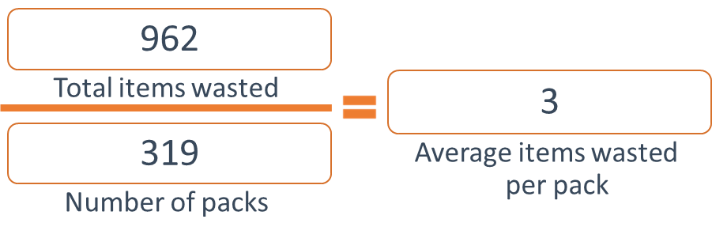
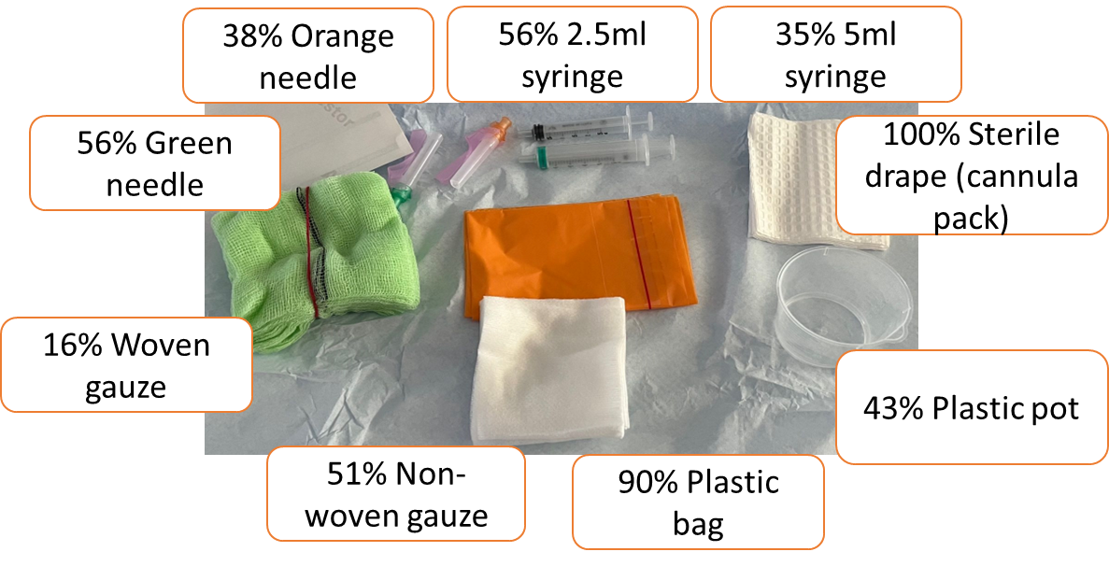
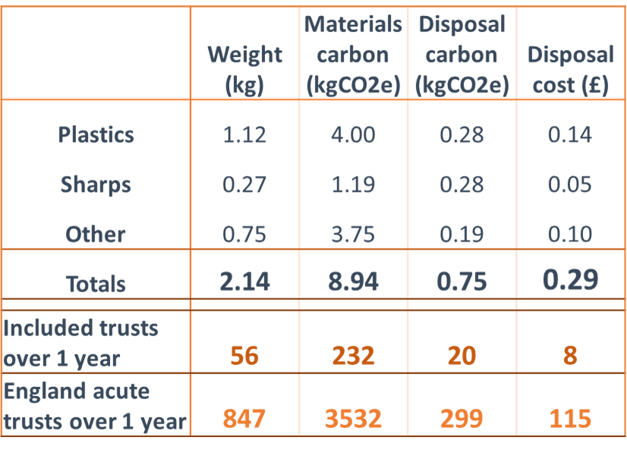
Sustainable Waste Management in Anaesthesia and Critical Care Project Dr Lucy Brooks MBChB (Hons), MA [1]. Dr Catherine Anderson MBChB, FRCA, FFICM. [2] Dr Esmé Ward MBChB, MRes, BSc (Hons) [3].
Institutions: [1] and [3] Health Education England, Yorkshire and Humber. [2] Sheffield Teaching Hospitals NHS Trust.
lucy.brooks@doctors.org.uk
The NHS is responsible for 4% of the UK carbon footprint; waste and water are together responsible for 5% of this, the same as anaesthetic gases and metered dose inhalers in combination.
The NHS has set targets to have net-zero emissions by 2040 from direct patient care, and including the supply chain by 2045 (1). A survey of anaesthetists at Leeds Teaching Hospitals NHS Trust regarding reducing the environmental impacts of anaesthesia identified waste management as an area anaesthetists want to prioritise. Anecdotally, anaesthetists report discarding single use items from pre-made device insertion packs without having used them for a patient. This is therefore a potential waste hotspot that could be tackled to reduce environmental and financial costs.
All data
What does this mean?
All of the pre-made packs currently utilised by participating Trusts include single-use items that were thrown away without having been used. This waste has environmental, financial and social impacts.
The combined carbon footprint of the wasted items materials and their disposal from the participating Trusts over one year (250kgCO2e) is equivalent to 676 miles driven in an average petrol car. Scaled up to include all the Trusts in England the carbon footprint is equivalent to 8767 miles driven, or the energy of 430 thousand smartphones charged (5).
What next?
We aim to use this data to work together with healthcare staff, procurement teams and suppliers to reduce waste from single-use device insertion packs. This might include exploring reusable options and removing unnecessary items from pre-made packs.
Every pack included unused wasted items.
Background
Environmental
Financial
Social
Carbon footprint, water use, pollution associated with:
Production
Packaging
Transport
Waste disposal
Cost
Purchase
Disposal
Frustration and anger disposing clean, unused items
Waste hotspots
Aim: To identify whether items are wasted from commonly used pre-made packs in anaesthesia and critical care, and if so, quantify the carbon footprint and financial costs of this waste.
Results
Discussion
Research was undertaken as a region-wide collaboration between the Yorkshire Green Anaesthesia Society and the local trainee research networks for Yorkshire – SHARC and AARMY.
Ten hospitals in Yorkshire and Humber contributed data to the project.
Data was collected for a period of two weeks on the items discarded unused from the following premade packs in anaesthesia and critical care; spinal, arterial line, central line and cannula.
Waste hotspots were identified as items most commonly discarded unused across all pack types. The total carbon equivalent of the top nine items thrown away, for which material information was available was estimated using a using a ‘bottom up’ approach.
One of each item was broken down, and the constituent materials were identified and weighed. The weight for each item was multiplied by a conversion factor from the ICE database (2). Carbon footprint and cost of disposal was calculated (3). The carbon footprint and cost for this waste across England per year was then extrapolated based on 152 acute hospital Trusts (4).
Table 1: Hotspot weight, carbon footprint of materials and disposal and disposal cost
Methods
Acknowledgements: Undertaken in collaboration with Yorkshire Green Anaesthesia Society, Anaesthetic Audit and Research Matrix of Yorkshire, South Yorkshire Hospitals Audit and Research Collaboration.No funding was received for this project.
References
NHS. Delivering a ‘net zero’ national health service. 2020. [Accessed 20/12/21] Available from: https://www.england.nhs.uk/greenernhs/wp-content/uploads/sites/51/2020/10/delivering-a-net-zero-national-health-service.pdf
Circular Ecology. 2019. Embodied Carbon – The ICE database. [Accessed 06/03/2023] Available from: https://circularecology.com/embodied-carbon-footprint-database.html
Rizan C, Bhutta M F, Reed M, Lillywhite R. The carbon footprint of waste streams in a UK hospital. Journal of Cleaner Production. 2021; 286
NHS Confederation (2017). Key Statistics on the NHS. [Accessed 6/3/23] Available from: https://www.nhsconfed.org/publications/key-statistics-nhs
Environmental Protection Agency. (2022). Greenhouse Gas Equivalencies Calculator. [Accessed 06/03/2023] Available from: https://www.epa.gov/energy/greenhouse-gas-equivalencies-calculator

